Slide 1
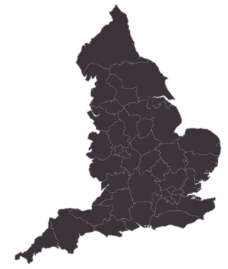
About the South London Cardiac ODN
The South London Cardiac ODN covers a population of 3.1 million, with collaborative links into Kent, Surrey, and Sussex.
Workstreams
The network portfolio covers clinical sub specialty workstreams with cross cutting elements, and aligned collaboration with ICBs.
Together with our South London partners, we are improving quality and population health, reducing inequalities, and creating value and future sustainability.
Clinical sub speciality workstreams | Cardiac surgery | Cardiac rehabilitation | Cardiac rhythm management | Heart failure
 | Inherited cardiac conditions | Stable chest pain | Revascularisation / interventional | Structural heart valve disease
ODN allied / ICB led workstreams | Diagnostics | Outpatients | Prevention
Crosscutting workstreams | Data collection, analysis and reporting
 | Inter hospital transfers (IHT)
 | Multidisciplinary team (MDT) working
 | Patient / public engagement and involvement
 | Primary care education
 | Procurement
Network members
2
ICSs
NHS South East London ICS
NHS South West London ICS
Guy’s and St Thomas’ NHS Foundation Trust
King’s College Hospital NHS Foundation Trust
St George’s University Hospitals NHS Foundation Trust
3
Finances
and staffing
7
secondary care sites
tertiary providers
The South London Cardiac ODN creates economies of scale by consolidating resources wherever possible for greater efficiencies. Network Manager and Business Development is jointly resourced with the Vascular Networks.
Croydon Health Services NHS Trust
Epsom and St Helier University Hospitals NHS Trust
Kington Hospital NHS Foundation Trust
Lewisham and Greenwich NHS Trust
Princess Royal University Hospital
Cardiac ODN
£393k
Croydon
Kingston
Merton
Richmond
Sutton
Wandsworth
Bexley
Bromley
Greenwich
Lambeth
Lewisham
Southwark
5.5
for
12
network staff
boroughs
2
clinical leads
Notes:
Work in line with triple aim
Spans clinical, financial, efficiency,
How we build / maintain relationships, integrate, and align with ICBs – eg, note shared bids, workstream attendance, personal / robust relationships (call on to help), eg strategy docs

Slide 2
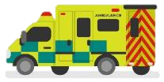
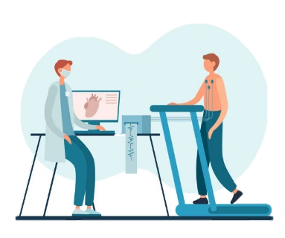
2022-23 in review
IHT monitoring – Weekly network inter hospital transfer (IHT) coordination meetings across enable safer patient care and greater efficiencies through escalation and distribution of patients to tertiary sites.
Ortus remote monitoring - The network implemented a digital monitoring solution pilot to provide safer care for the 8,000 patients awaiting surgery in the capital. Approximately 2,000 have been onboarded to the tool, and 184 patients have had their care escalated.
SGH treat and return – The network supported SGH to implement a treat and return inter hospital transfer (IHT) pathway for patients requiring angio / PCI procedures. This unified SL pathway creates savings, improves bed capacity at tertiary sites and ensures patients are supported in their local hospital, close to home.
Achievements
OPAT - The network worked with KCH to establish an outpatient parenteral antimicrobial therapy service, which provides patients with IV antibiotics at home, releasing hospital beds
for other care.
1,200 bed days were
saved in five months.
Health inequalities in heart valve disease – Extensive engagement of Black African and Caribbean communities to understand behaviours and barriers to care resulted in an eye-opening report with 20 recommendations for improvements.
Collaborative procurement – The network manages ongoing compliance of the aggregate purchasing and contracts for stents. This year, the position was improved from 58% to 75%, resulting in further savings of £250k for network members.
Cardiac rehab – Successfully obtained funding with acute and community cardiac rehabilitation providers to provide additional nursing and physiotherapy resources and a digital pilot of tailored exercise programmes.
Core learning in inherited cardiac conditions (CLICC) – Delivered six sessions across the year offering virtual upskilling to 2,300 non ICC colleagues in vital areas – across the globe!
Lessons learned
Disconnect between local and regional priorities (eg London prevention agenda unclear of ICB remit and ownership)
Mitigations: EMB support to ensure proper consultation with SL ICBs with pan London alignment through London Partnership Board; London workstreams dissolved or passed to ODN
Lack of clarity around national CPIP funding that was retained by region, impacting ODN plans
Mitigations: Ongoing dialogue with region and specialised commissioning for greater transparency of funding in 2023/24

Slide 3
Cardiac ODN: Improving equity, access and outcomes for cardiovascular care across South London
Enriching the system through supporting...
Insight
Learning
Delivering international ICC online education programme
Hosting F2F and online clinical forums and best practice events for ICC, Heart Failure, Arrhythmia, Chest Pain and Valve Disease
Delivering regular schedule of secondary, GP and primary care education events
Developing standard patient resources across Trusts, including targeted materials
Facilitating training and development for MDT working - peer reviewing MDTs, skills building for virtual MDT chairpersons
Activity
Weekly cardiac and cardiology activity & waiting list demand and capacity report
Weekly Inter-hospital transfer performance
Measuring Performance
National quality measures
CPIP & GIRFT metrics, self-assessment
Clinical Audit & QI
Joint Cardiothoracic / Cardiology MDT
Chest pain service
Cardiac Surgery clinical governance
Patient-led design
Digital Innovation
Governance
Patient initiated follow up (PIFU)
Engaging Black communities in SE London
Acute Aortic Dissection pathway
Cardiac Rehab
App development: cardiac surgery remote monitoring, rehabilitation
Integrated working - virtual network-wide MDTs
Aligning cardiac surgery clinical governance across all units
Network reporting of outcomes for TAVI, ablation, MitraClip & cardiac surgery
Developing end to end cardiac pathways through…
BETTER DATA
BETTER SYSTEMS
Diagnosis and management
Prevention
Detection
Rehabilitation
Community
Working with ICB and HIN led programmes on lipids, hypertension and AF, supporting PCNs with detection and management of hypertension and addressing inequalities
Pharmacy collaboration on secondary prevention for ACS patients
Improve detection and management of familial hypercholesterolaemia
Mobile valve clinics for GP practices in S London to increase detection of valve disease in the community
Developing pathways into CDCs with ICBs
Improving echo wait times including pilot training programme for acute and general medicine Drs to deliver level 1 echo
Improving GP access to ECGs for chest pain pathway
Streamlining non-elective pathways with Ambulance services
Emergency EP and pacing
Acute Aortic Dissection
Strengthening MDT working
Establishing a S London Mitral valve team and single point of access between surgery and cardiology
Integrating the percutaneous & surgical valve pathways
Standardising ablation treatment across SL
Developing the standardised major aortic pathways
Operational efficiency
Weekly tertiary ops & nursing review of IHT referrals for cardiology & cardiac surgery to prioritise transfers and discuss capacity
Supporting faster repatriation through implementing treat & return pathways (PCI) and reviewing post-procedure observation protocols (CRM device checks)
Saturdays lists for PCI to improve waiting times
OPAT for cardiac infections
Savings through collaborative TAVI procurement
HF medicines management optimisation
Piloting a rehab exercise app for patients
Funding workforce and space gaps to address variation in access to rehab
Establishing a SL rehab network group to collectively improve performance in the national audit
Completing pilot of remote monitoring patients waiting for cardiac surgery and use for chronic cardiac conditions
Review home visit protocol for patients with cardiac rhythm management devices
Mobile valve clinics

